Slide 1
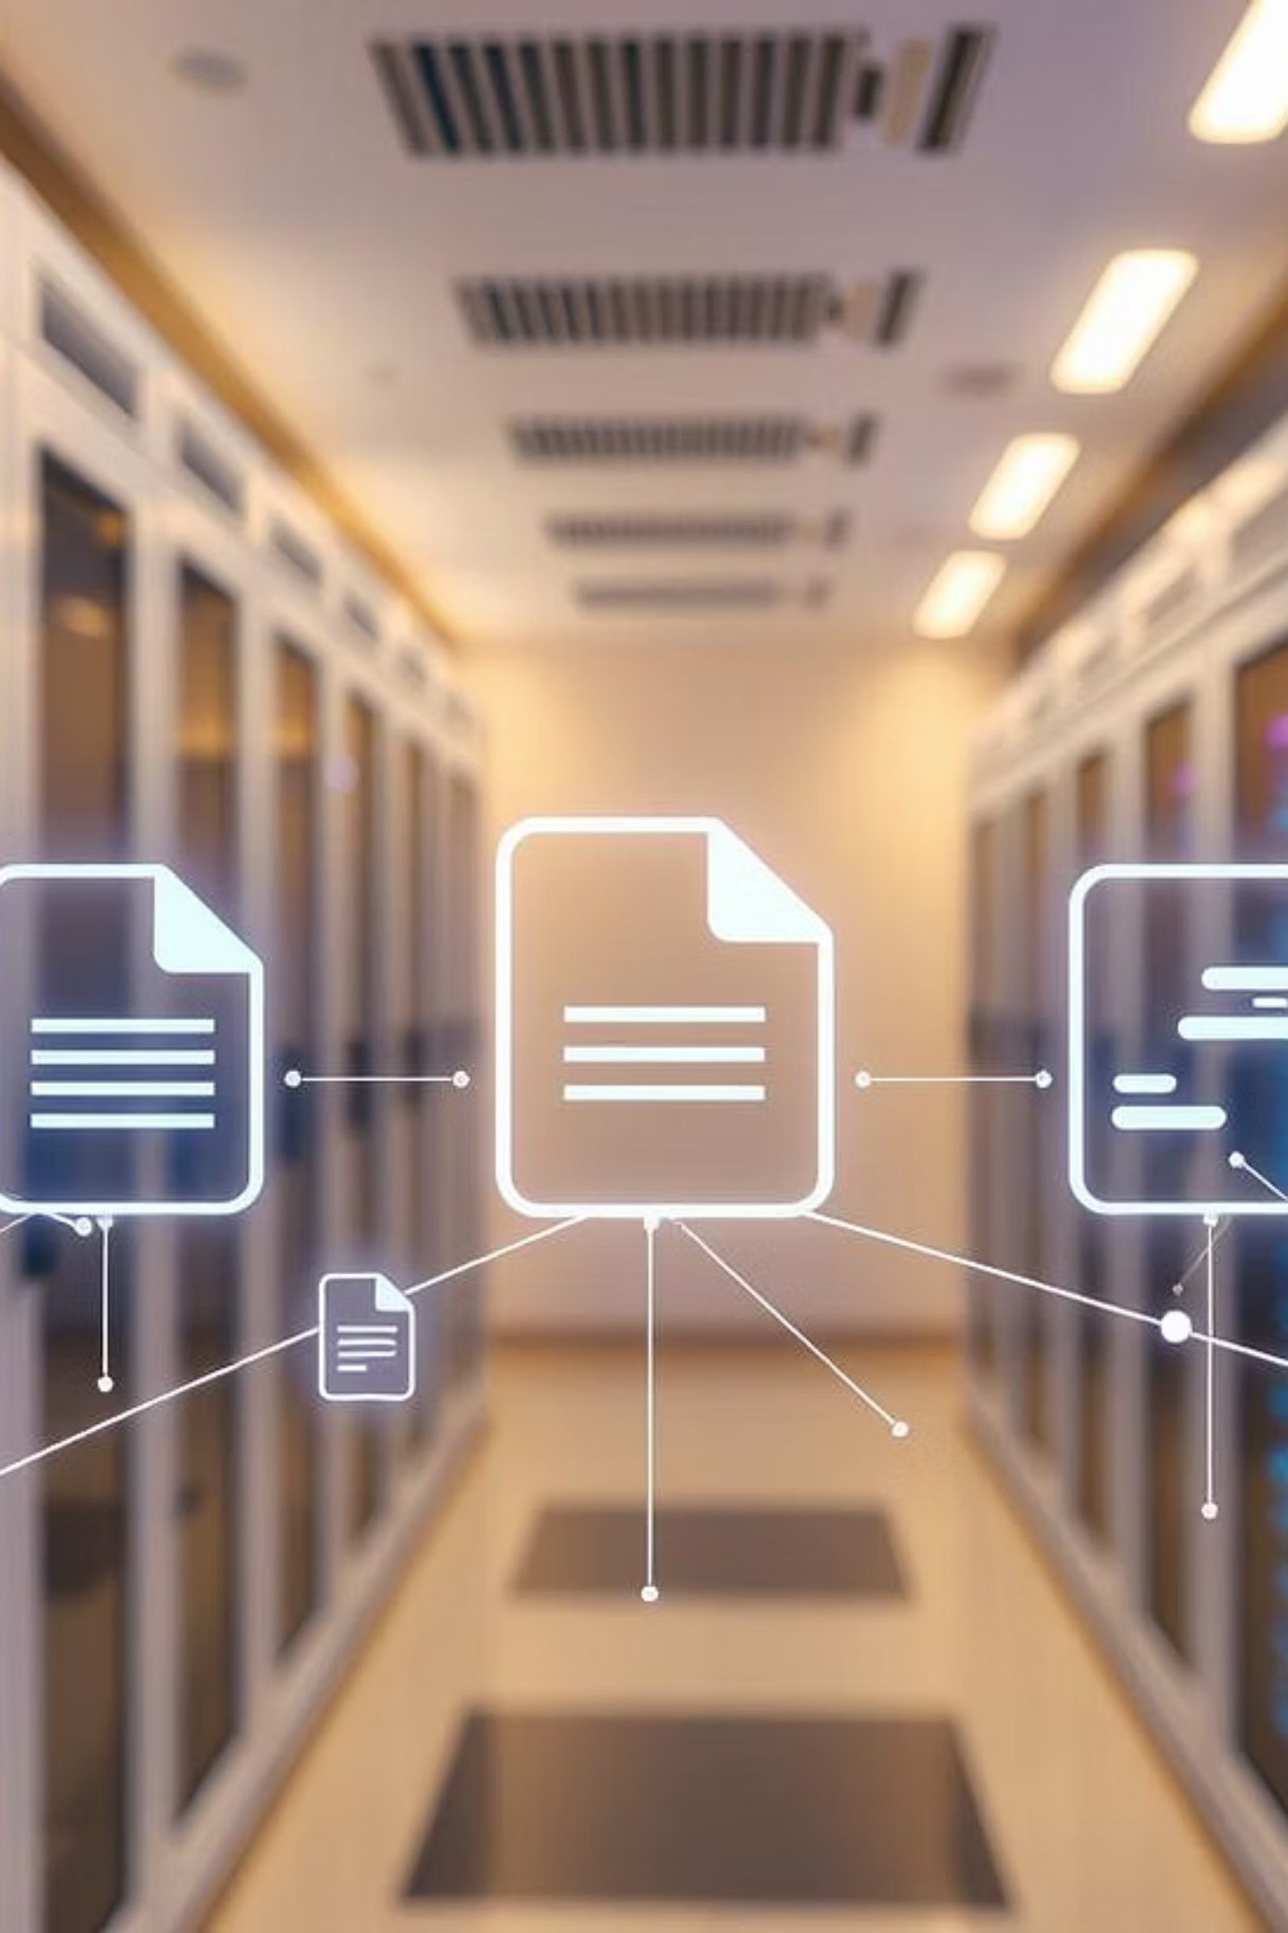
Universal Table Extractor
Extract tables from any document format using AI + traditional methods

Slide 2
Problem Statement
Diverse Document Formats
Manual Extraction Inefficiency
Businesses receive critical tabular data embedded in varied document types, from PDFs and images to presentations.
Current manual data extraction is a time-consuming and error-prone process, leading to operational bottlenecks.
Limitations of Traditional Tools
Need for a Universal Solution
Existing rule-based extractors often fail when encountering complex layouts, scanned documents, or handwritten content.
There's a pressing need for a universal, fast, and intelligent system that can accurately extract tabular data regardless of source or format.

Slide 3
Project Objectives
Our Universal Table Extractor aims to provide a robust solution by addressing the core challenges of data extraction.
1
Comprehensive Format Support
2
Hybrid Extraction Approach
Support for all major document formats, including PDF, DOCX, PPTX, Excel, and various image types.
Prioritize fast, library-based extraction with a seamless fallback to advanced AI/ML models for complex cases.
3
Advanced Content Handling
4
User-Friendly Interface & API
Implement AI models like Donut or leverage cloud services such as Azure Form Recognizer for scanned, noisy, or handwritten data.
Develop both a intuitive web interface and a programmatic API for broad user accessibility and integration.

Slide 4
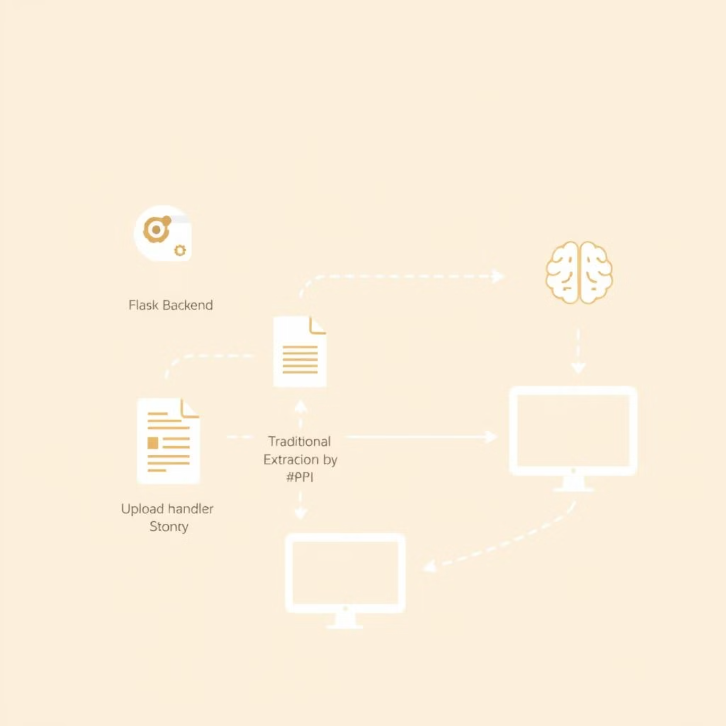
System Architecture
The Universal Table Extractor is designed with a modular and scalable architecture to ensure efficient and reliable data processing.
Flask Backend: Handles core logic, file processing, and API endpoints.
HTML Frontend: Provides an intuitive user interface for file uploads and result display.
File Handling: Securely saves uploaded documents to a dedicated directory (/uploads).
Intelligent Dispatch: Dynamically selects the optimal extraction method based on document file type.
Hybrid Extraction Logic: Prioritizes fast, traditional libraries, falling back to AI models if initial attempts fail.
Structured Output: Presents extracted tables in a clean, structured format via the UI or API.

Slide 5
Libraries and Tools
Our system leverages a robust stack of libraries and tools, combining fast, traditional parsers with advanced AI capabilities for comprehensive table extraction.
Web Framework
Flask, Werkzeug
Building the web interface and handling file uploads.
Primary Extractors
pdfplumber, python-docx, python-pptx
Fast, rule-based extraction from digital PDF, DOCX, and PPTX files.
AI Extraction
Donut (Transformer Model)
Vision-based transformer model for advanced table extraction from images.
Cloud AI/OCR
Azure Form Recognizer, pytesseract (OCR)
Layout analysis, OCR, and table extraction from scanned or complex documents.
Data Parsing
pandas, Beautiful Soup (bs4)
Parsing structured data from Excel, CSV, and HTML formats.

Slide 6





How It Works (Logic)
1. File Upload
Users initiate the process by uploading a document via the web UI or API.
2. File Type Detection
The system automatically identifies the document format (e.g., PDF, DOCX, JPG).
3. Fast Parser Attempt
A rapid, format-specific parser (e.g., pdfplumber) attempts initial extraction.
4. AI Fallback
If the fast parser yields no results, the system invokes AI models (Donut or Azure) for deeper analysis.
5. Structured Output
Extracted tables are presented in a clean, structured view, ready for consumption.

Slide 7





Key Features
Multi-Format Support
Fast Local Processing
AI-Powered OCR
Processes a wide array of document types including PDFs, DOCX, PPTX, XLSX, and various image formats.
Prioritizes efficient local libraries for quick extraction, with intelligent fallbacks for complex scenarios.
Utilizes advanced AI models for robust Optical Character Recognition, handling scanned, noisy, or handwritten tabular data.
API and UI Integration
Complex Table Handling
Offers both a user-friendly web interface for direct interaction and a flexible API for seamless system integration.
Intelligently supports and reconstructs complex table structures, including merged cells, column spans, and row spans.

Slide 8
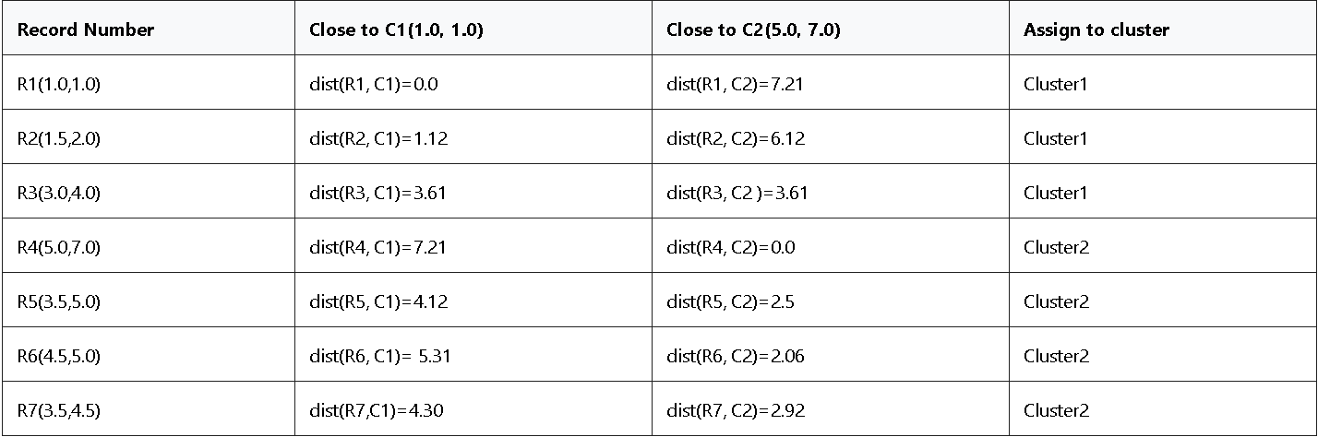
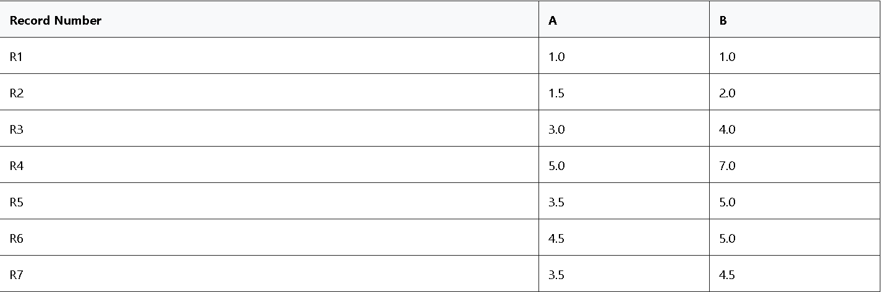
Results & Output Format
The Universal Table Extractor delivers highly structured and usable data, designed for both human readability and machine consumption.
Header Detection: Automatically identifies and correctly labels table headers for clarity.
Flexible Formats: Supports both traditional row-column and grid formats for diverse data representation.
Graceful Handling: Accurately interprets and represents merged cells and intentional missing cells without data loss.
Browser View: Extracted tables are rendered visually in the web browser for immediate review.
API Output: Provides structured JSON output via the API, enabling easy integration with other systems.

